Slide 1
EVOLVING ARCHITECTURE WITH DDD AND HYPERMEDIA
@EINARWH

Slide 2


Slide 3
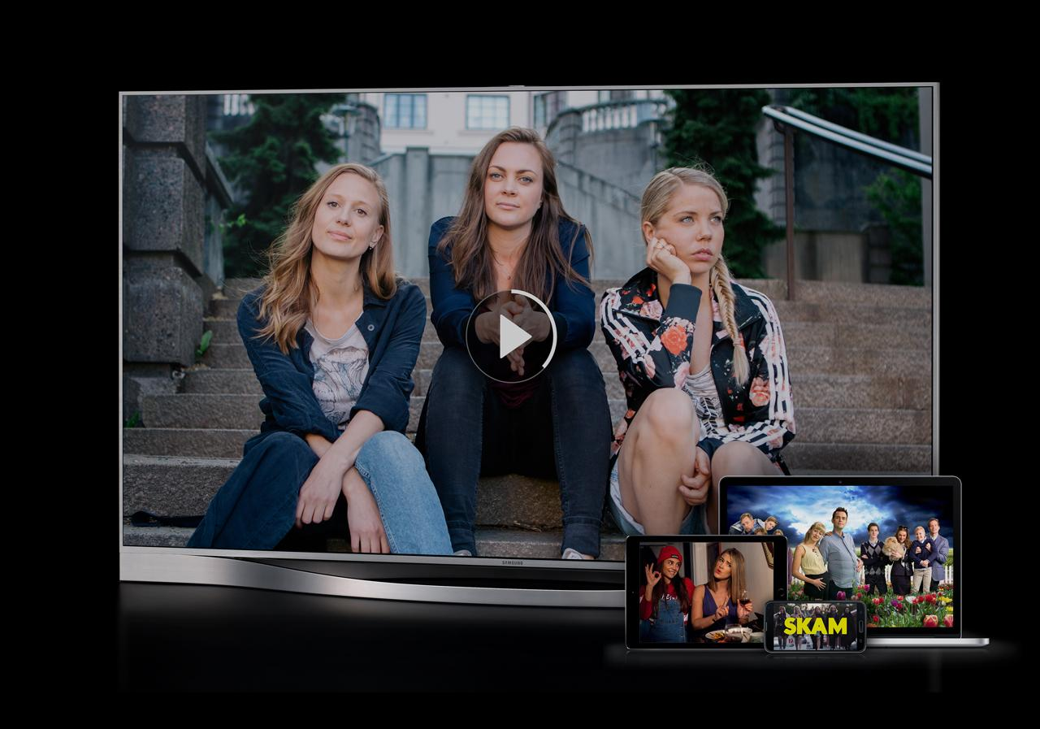

Slide 4
WHY HYPERMEDIA?

Slide 5
BECAUSE IT’S IN VOGUE?

Slide 6
BECAUSE IT’S COOL?

Slide 7
BECAUSE I LIKE IT?

Slide 8
NO!

Slide 9
BECAUSE IT HELPS US!

Slide 10
HYPERMEDIA AS ENABLER FOR BETTER ARCHITECTURE

Slide 11
THIS IS AN ARCHITECTURE TALK

Slide 12
STRANGLING THE MONOLITH WITH HYPERMEDIA

Slide 14
AGENDA

Slide 15
ARCHITECTURE CHALLENGES AT NRK TV

Slide 16
INTRODUCTION TO HYPERMEDIA

Slide 17
HYPERMEDIA IN PRACTICE AT NRK TV

Slide 19
ARCHITECTURE CONCERNS AT NRK TV

Slide 20
SOCIO-TECHNICAL CONTEXT

Slide 21
BUSINESS PERSPECTIVE

Slide 22
RAPIDLY EVOLVING DOMAIN

Slide 23
MUST STAY COMPETITIVE

Slide 24
MUST BE NIMBLE

Slide 25
ORGANIZATION

Slide 26
MULTIPLE TEAMS AT NRK TV

Slide 27
COLLABORATION WITH NRK RADIO AND NRK SUPER

Slide 28
INTERACTIONS WITH OTHER PARTS OF THE ORGANIZATION

Slide 29
A SYSTEM IN A SYSTEM OF SYSTEMS

Slide 30
WE MUST SUPPORT AUTONOMY

Slide 31
WE MUST SUPPORT EXPERIMENTS

Slide 32
WE MUST SUPPORT CHANGE

Slide 33
WE MUST PROVIDE STABILITY

Slide 34
WE MUST IMPROVE STABILITY

Slide 35
TECHNICAL PERSPECTIVE

Slide 36
THE NRK TV PLAYER API

Slide 37
MANY CLIENTS

Slide 38
PROGRESSIVE CLIENTS

Slide 39
LEGACY CLIENTS

Slide 40
IMPACT ON ARCHITECTURE

Slide 42
CA 2016

Slide 43
MONOLITHIC WEB API SERVING MANY CLIENTS

Slide 44
RUNS IN AZURE TWO DATA CENTERS

Slide 45
BACKED BY RELATIONAL DATABASE

Slide 46
VARIOUS SUPPORTING WORKER JOBS

Slide 47
CUNNING CACHING SCHEMES

Slide 48
OVERWHELMING COMPLEXITY

Slide 49
LARGELY UNREASONABLE

Slide 50
COMPLEX FAILURE MODES

Slide 51
UNFORESEEN EFFECTS OF CHANGE

Slide 52
BUGS

Slide 53
FEAR OF CHANGE

Slide 54
STAGNATION

Slide 55
IMPACT ON LEAD TIME

Slide 56
RELIANCE ON RELEASE MANAGER GENIUS

Slide 57
WHAT TO DO?

Slide 58
REWRITE?

Slide 59
WHAT DO YOU MEAN REWRITE?

Slide 60
WE CAN’T REWRITE!

Slide 61
SO HOW DO WE REWRITE?

Slide 62
WE MUST EVOLVE!

Slide 64
WHERE DID THE MONOLITH COME FROM?

Slide 65
THE ENTITY

Slide 66
THE ENTITY IS THE MONOLITH

Slide 67
THE ENTITY SNOWBALLS COMPLEXITY

Slide 68
THE ENTITY IS THE BIG BALL OF MUD

Slide 69
FOR NRK TV THE TV SHOW IS THE ENTITY

Slide 70
WHAT IS A TV SHOW?

Slide 71
ACCESSIBILITY
CDN
MEDIA MANIFEST
BINGE WATCHING
RATING
IMAGES
USAGE RIGHTS
SERIES
EPISODES
FAVORITES
PROMOTIONS
TV
SHOW
TV
SHOW
ON DEMAND
IP CHECK
REPORTING
HIT TITLES
SEARCH
AGE CONTROL
SUBTITLES
CATEGORY
RECOMMENDATIONS
HISTORY
CONTRIBUTORS
POPULARITY
LIVE

Slide 72
WHO’S ASKING?

Slide 73
FUNCTIONAL DECOMPOSITION

Slide 74
BOUNDED CONTEXTS

Slide 75
TV SHOW IN THE CATALOG CONTEXT

Slide 76
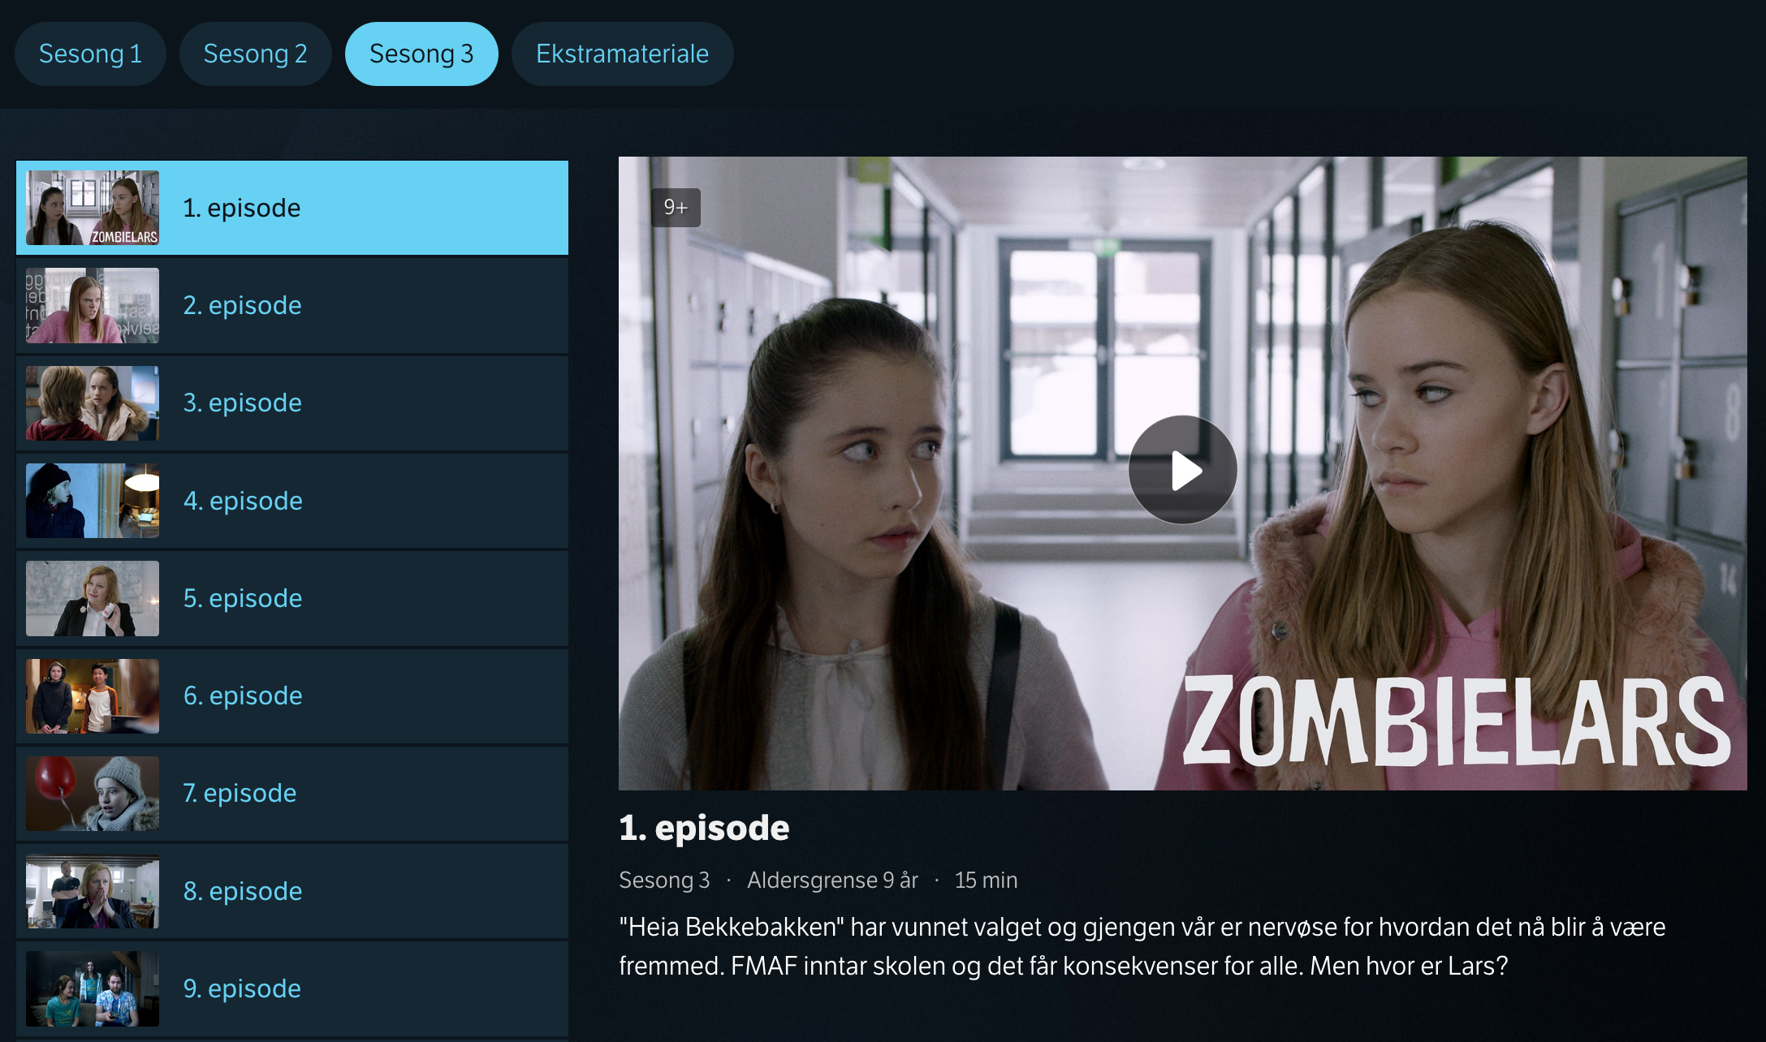

Slide 77
COMPLEXITY WITH RESPECT TO

Slide 78
METADATA DESCRIBING THE MEDIA CONTENT

Slide 79
WHAT KINDS OF TV SHOWS ARE THERE?

Slide 80
HOW SHOULD THEY BE PRESENTED?

Slide 81
WHAT’S THEIR LOGIC?

Slide 82
A TV SERIES WITH EPISODES IS DIFFERENT FROM THE DAILY NEWS IS DIFFERENT FROM A SPORTS EVENT IS DIFFERENT FROM A TALK SHOW IS DIFFERENT FROM A DOCUMENTARY IS DIFFERENT FROM …

Slide 83
DIFFERENT CONTENT IS CONSUMED DIFFERENTLY

Slide 84
TV SHOW IN THE PLAYBACK CONTEXT

Slide 85
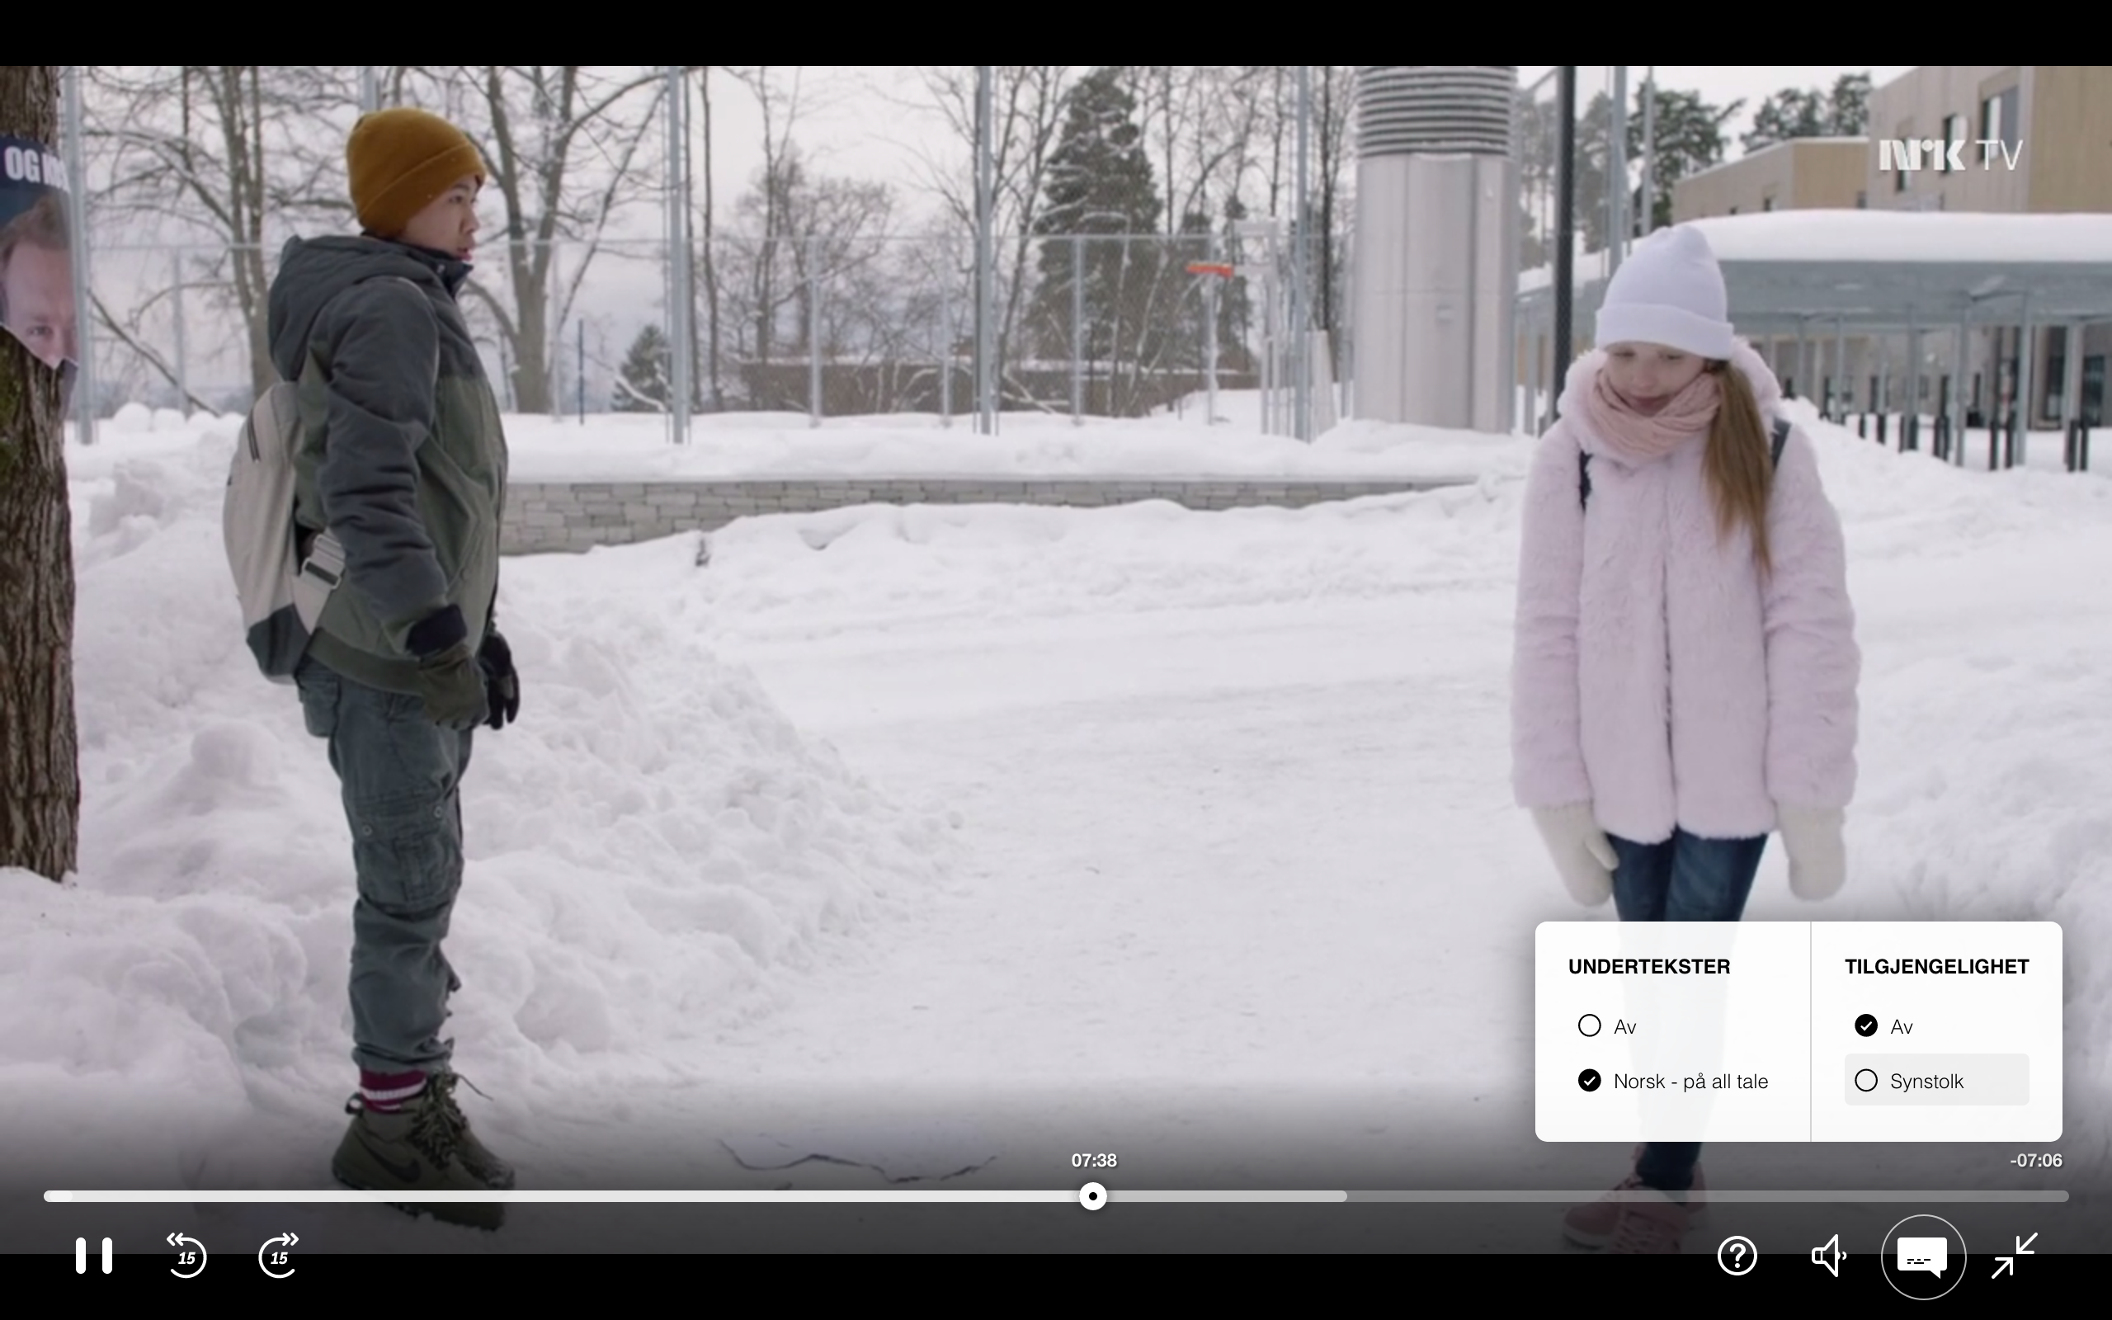

Slide 86
COMPLEXITY WITH RESPECT TO

Slide 87
PLAYING THE ACTUAL MEDIA CONTENT

Slide 88
SUPPORT FOR VARIOUS KINDS OF MEDIA MANIFESTS

Slide 89
STREAMING QUALITY

Slide 90
ADAPTING BIT RATE TO DEVICE AND NETWORK

Slide 91
SUPPORTING ACCESSIBILITY VERSIONS

Slide 92
WHAT ABOUT OTHER CONTEXTS?

Slide 93
CATALOG
DESKING
SEARCH
TV
SHOW
RECOMMEND
ATIONS
PERSONAL IZATION
PLAYBACK

Slide 94
CONTAINMENT OF COMPLEXITY

Slide 95
DIFFERENT GOALS AND REQUIREMENTS

Slide 96
CATALOG
DESKING
SEARCH
TV
SHOW
RECOMMEND
ATIONS
PERSONAL IZATION
PLAYBACK

Slide 97
CATALOG
DESKING
SEARCH
CRITICALITY?
TV
SHOW
RECOMMEND
ATIONS
PERSONAL IZATION
PLAYBACK

Slide 98
CATALOG
DESKING
SEARCH
TV
SHOW
RECOMMEND
ATIONS
PERSONAL IZATION
PLAYBACK

Slide 99
CATALOG
DESKING
SEARCH
TV
SHOW
RECOMMEND
ATIONS
PERSONAL IZATION
PLAYBACK

Slide 100
CATALOG
DESKING
SEARCH
TV
SHOW
RECOMMEND
ATIONS
PERSONAL IZATION
PLAYBACK

Slide 101
CATALOG
DESKING
SEARCH
CACHING?
TV
SHOW
RECOMMEND
ATIONS
PERSONAL IZATION
PLAYBACK

Slide 102
CATALOG
DESKING
SEARCH
TV
SHOW
RECOMMEND
ATIONS
PERSONAL IZATION
PLAYBACK

Slide 103
CATALOG
DESKING
SEARCH
TV
SHOW
RECOMMEND
ATIONS
PERSONAL IZATION
PLAYBACK

Slide 104
CATALOG
DESKING
SEARCH
TV
SHOW
RECOMMEND
ATIONS
PERSONAL IZATION
PLAYBACK

Slide 105
CATALOG
DESKING
SEARCH
FAILURES?
TV
SHOW
RECOMMEND
ATIONS
PERSONAL IZATION
PLAYBACK

Slide 106
CATALOG
DESKING
SEARCH
TV
SHOW
RECOMMEND
ATIONS
PERSONAL IZATION
PLAYBACK

Slide 107
CATALOG
DESKING
SEARCH
TV
SHOW
RECOMMEND
ATIONS
PERSONAL IZATION
PLAYBACK

Slide 108
UNIFORMLY CRITICAL

Slide 109
NOT EASILY CACHEABLE

Slide 110
NO PARTIAL SUCCESS

Slide 111
PRONE TO FAIL HARD

Slide 112
HARD TO REASON ABOUT

Slide 114
WHAT TO DO?

Slide 115
LOBBY FOR AND ELECT AN ARCHITECT

Slide 116
BOUNDED CONTEXT AS SERVICE BOUNDARY

Slide 117
NEW STUFF AS NEW SERVICES

Slide 118
GATEWAY AS ARCHITECTURE SEAM

Slide 119
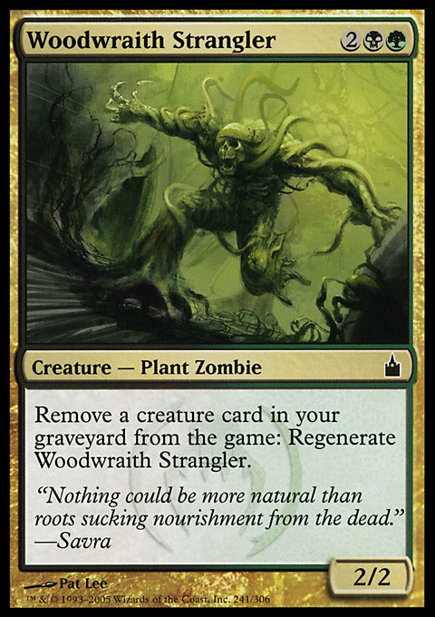
STRANGLER PATTERN

Slide 120
EXPERIMENT WITH HYPERMEDIA

Slide 121
RECOMPOSE WHAT WE DECOMPOSE

Slide 122
NAVIGATE SEAMLESSLY ACROSS BOUNDARIES

Slide 123
INTEGRATED EXPERIENCE

Slide 125
WHAT IS HYPERMEDIA?

Slide 126
MEDIA WITH LINKS

Slide 127
LINKS HAVE SEMANTICS

Slide 128
LINK RELATIONS

Slide 129
LINK PRESENCE IS DYNAMIC AND MEANINGFUL

Slide 130
LINKS AS AFFORDANCES

Slide 131
LINKS TURN RESOURCES INTO JUNCTIONS

Slide 132
LINKS ANSWER THE QUESTION: NOW WHAT?

Slide 133
THERE SHOULD BE A LINK FOR EACH WAY FORWARD

Slide 134
RESOURCES CONNECT TO FORM NARRATIVES

Slide 162
5XX

Slide 163
5XX

Slide 164
5XX

Slide 165
5XX

Slide 169
PLAYBACK
CATALOG
PERSONAL IZATION
DESKING

Slide 170
PLAYBACK
CATALOG
PERSONAL IZATION
DESKING

Slide 171
EVOLUTION & VERSIONING

Slide 172
THE CLASSICAL QUESTION: WHICH VERSIONING SCHEME?

Slide 173
NOT REALLY RELEVANT

Slide 174
RARELY USEFUL TO REPLACE INDIVIDUAL ENDPOINTS

Slide 175
OFFER NEW AND IMPROVED NARRATIVES

Slide 176
USE LINKS TO OFFER NEW ALTERNATIVES TO CLIENTS

Slide 177
IDENTIFY NARRATIVES BY LINK RELATIONS

Slide 178
LET THE CLIENT OPT-IN TO NEW ALTERNATIVES

Slide 179
WE CAN TRACK WHICH CLIENTS USE WHICH NARRATIVES

Slide 180
CLIENTS SELF-IDENTIFY THROUGH USER AGENT HEADER

Slide 181
EVENTUALLY REMOVE LINKS TO OBSOLETE NARRATIVES

Slide 182
CATALOG
PLAYBACK
PERSONAL IZATION
DESKING

Slide 183
LEGACY
CATALOG
PLAYBACK
PERSONAL IZATION
DESKING

Slide 184
LEGACY
CATALOG
PLAYBACK
EPISODE
SERIES
SERIES
PERSONAL IZATION
DESKING

Slide 185
LEGACY
CATALOG
PLAYBACK
EPISODE
SERIES
SERIES
PERSONAL IZATION
TV SHOW PAGES
DESKING

Slide 186
LEGACY
CATALOG
PLAYBACK
EPISODE
PROGRAMPAGE
SERIES
showpage
SERIES
PERSONAL IZATION
showpage
TV SHOW PAGES
DESKING

Slide 187
LEGACY
CATALOG
PLAYBACK
EPISODE
SERIES
SERIES
PERSONAL IZATION
DESKING

Slide 188
LEGACY
CATALOG
PLAYBACK
EPISODE
PROGRAMPAGE
SERIES
showpage
SERIES
PERSONAL IZATION
showpage
TV SHOW PAGES
DESKING

Slide 189
LEGACY
CATALOG
PLAYBACK
EPISODE
PROGRAMPAGE
SERIES
showpage
SERIES
PERSONAL IZATION
showpage
TV SHOW PAGES
DESKING

Slide 190
LEGACY
CATALOG
PLAYBACK
EPISODE
PROGRAMPAGE
SERIES
showpage
SERIES
PERSONAL IZATION
showpage
TV SHOW PAGES
DESKING

Slide 191
LEGACY
CATALOG
PLAYBACK
EPISODE
PROGRAMPAGE
SERIES
showpage
SERIES
PERSONAL IZATION
showpage
TV SHOW PAGES
DESKING

Slide 192
LEGACY
CATALOG
PLAYBACK
EPISODE
PROGRAMPAGE
SERIES
showpage
SERIES
PERSONAL IZATION
showpage
TV SHOW PAGES
DESKING

Slide 193
PLAYBACK
PROGRAMPAGE
showpage
PERSONAL IZATION
showpage
TV SHOW PAGES
DESKING

Slide 194
HYPERMEDIA APPLICATION LANGUAGE

Slide 195
WHY HAL?

Slide 196
LIGHTWEIGHT

Slide 197
GRADUAL

Slide 198
RESOURCES HAVE LINKS AND STATE

Slide 199
RESOURCES MAY HAVE EMBEDDED RESOURCES

Slide 200
LINKS HAVE A TARGET AND A RELATION

Slide 201
HAL EXAMPLES

Slide 202
{
"_links":
{
"self":
{
"href": "tv/series/skam"
}
}
}

Slide 203
COLLECTION OF LINKS
{
"_links":
{
"self":
{
"href": "tv/series/skam"
}
}
}

Slide 204
{
"_links":
{
"self":
{
"href": "tv/series/skam"
}
}
}
LINK RELATION

Slide 205
{
"_links":
{
"self":
{
"href": "tv/series/skam"
}
}
}
TARGET

Slide 206
{
"_links":
{
"self":
{
"href": "tv/series/skam"
}
}
}
URI

Slide 207
COLLECTION OF LINKS
{
"_links": { "self": { "href": "/tv-show/1" }, "manifest": [{ "name": "default", "href": "/manifest/1" }, { "name": "synstolk", "href": "/manifest/2" }] }
}

Slide 208
{
"_links": { "self": { "href": "/tv-show/1" }, "manifest": [{ "name": "default", "href": "/manifest/1" }, { "name": "synstolk", "href": "/manifest/2" }] }
}
LINK RELATIONS

Slide 209
{
"_links": { "self": { "href": "/tv-show/1" }, "manifest": [{ "name": "default", "href": "/manifest/1" }, { "name": "synstolk", "href": "/manifest/2" }] }
}
NAME AS SECONDARY KEY

Slide 210
COLLECTION OF LINKS
{
"_links": { "self": {
"href": "/tv-show/1"
"progress": { "href": "/progress/{user}/1", "templated": true } }
}

Slide 211
{
"_links": { "self": {
"href": "/tv-show/1"
"progress": { "href": "/progress/{user}/1", "templated": true } }
}
LINK RELATIONS

Slide 212
{
"_links": { "self": {
"href": "/tv-show/1"
"progress": { "href": "/progress/{user}/1", "templated": true } }
}
TEMPLATED LINK

Slide 213
COLLECTION OF EMBEDDED RESOURCES
{ "_embedded": {
"favorite": { "_links": { "self": {
"href": "/tv-show/1" }
}
} }
}

Slide 214
{ "_embedded": {
"favorite": { "_links": { "self": {
"href": "/tv-show/1" }
}
} }
}
LINK RELATION

Slide 215
{ "_embedded": {
"favorite": { "_links": { "self": {
"href": "/tv-show/1" }
}
} }
}
EMBEDDED RESOURCE

Slide 216
EXAMPLES tv.nrk.no

Slide 217

DESKING

Slide 218
DESKING
{ "series": { "_links": { "self": { "href": "/series/heimebane" }, "image": { "href": "https://gfx.nrk.no/GKrIe1kJr" } }, "usageRights": { "isGeoBlocked": false }
}
}
EMBEDDED SERIES RESOURCE

Slide 219
DESKING
{ "series": { "_links": { "self": { "href": "/series/heimebane" }, "image": { "href": "https://gfx.nrk.no/GKrIe1kJr" } }, "usageRights": { "isGeoBlocked": false }
}
}
GO TO CATALOG CONTEXT

Slide 220
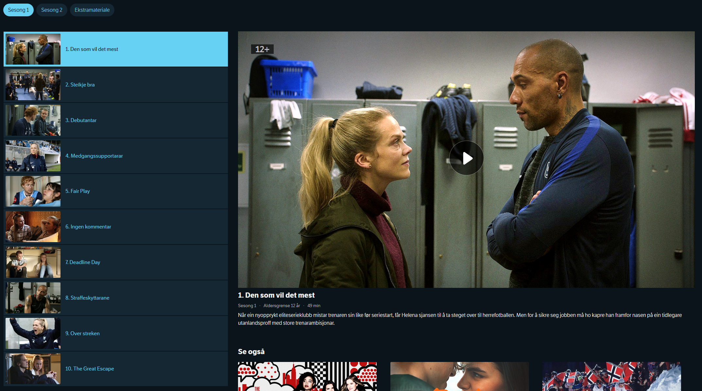
CATALOG
{ "_embedded": {
"episode": [{
"_links": {
"self": {
"href": "/programs/MDRI20000115"
},
"playback": {
"href": "/manifest/MDRI20000115"
},
"share": {
"href": "https://tv.nrk.no/se? v=MDRI20000115{&autoplay,t}",
"templated": true
} },
"title": "1. Den som vil det mest", "productionYear": 2018, "rating": "12+", ... }] } }
EMBEDDED EPISODE RESOURCE

Slide 221
CATALOG
{ "_embedded": {
"episode": [{
"_links": {
"self": {
"href": "/programs/MDRI20000115"
},
"playback": {
"href": "/play/MDRI20000115"
},
"share": {
"href": "https://tv.nrk.no/se? v=MDRI20000115{&autoplay,t}",
"templated": true
} },
"title": "1. Den som vil det mest", "productionYear": 2018, "rating": "12+", ... }] } }
GO TO PLAYBACK CONTEXT

Slide 222
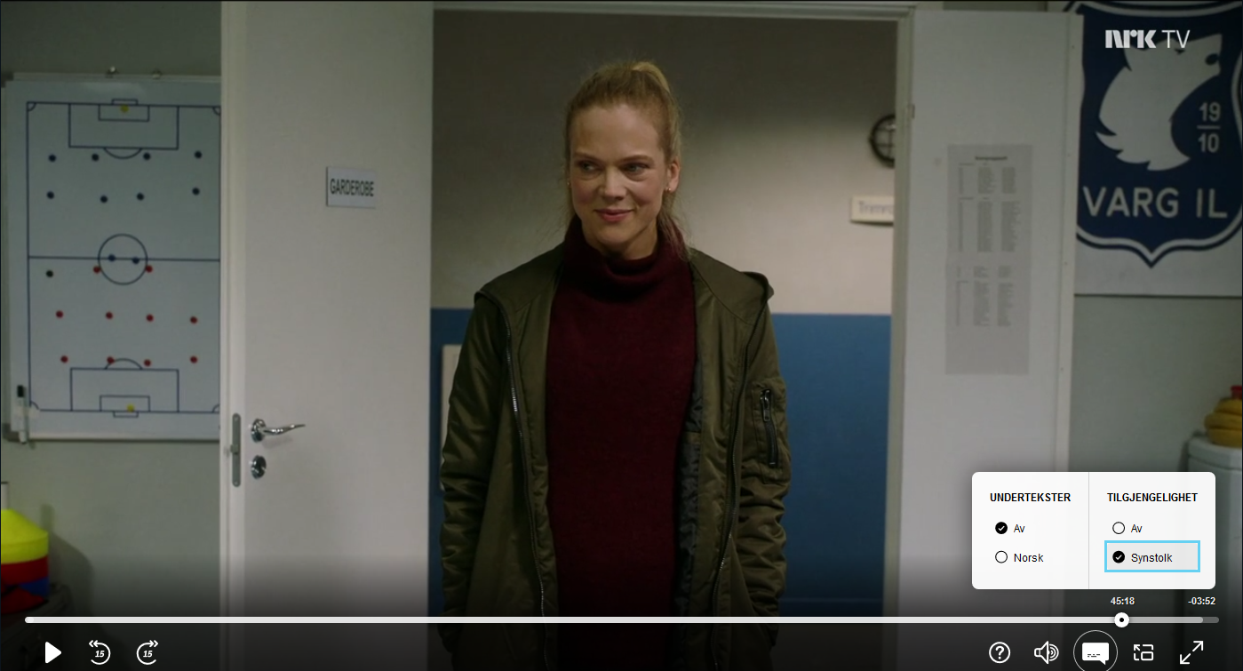
PLAYBACK
{ "_links": {
"self": {
"href": "/play/MDRI20000115"
},
"manifest": [{ "name": "default",
"href": "/manifest/MDRI20000115"
}, { "name": "synstolk",
"href": "/manifest/MDRI20000115SYNS"
}],
"next": {
"href": "/play/MDRI20000215" }, "series": {
"href": "/series/heimebane" }, "progress": {
"href": "/progress/{user}/MDRI20000215", "templated": true } }, "duration": "PT49M10.92S", ... }
EPISODE PLAYBACK RESOURCE
GO TO PLAYBACK CONTEXT

Slide 223
PLAYBACK
{ "_links": {
"self": {
"href": "/play/MDRI20000115"
},
"manifest": [{ "name": "default",
"href": "/manifest/MDRI20000115"
}, { "name": "synstolk",
"href": "/manifest/MDRI20000115SYNS"
}],
"next": {
"href": "/play/MDRI20000215" }, "series": {
"href": "/series/heimebane" }, "progress": {
"href": "/progress/{user}/MDRI20000215", "templated": true } }, "duration": "PT49M10.92S", ... }
RESOLVE MANIFEST URL
GO TO PLAYBACK CONTEXT

Slide 224
PLAYBACK
{ "_links": {
"self": {
"href": "/play/MDRI20000115"
},
"manifest": [{ "name": "default",
"href": "/manifest/MDRI20000115"
}, { "name": "synstolk",
"href": "/manifest/MDRI20000115SYNS"
}],
"next": {
"href": "/play/MDRI20000215" }, "series": {
"href": "/series/heimebane" }, "progress": {
"href": "/progress/{user}/MDRI20000215", "templated": true } }, "duration": "PT49M10.92S", ... }
ACCESSIBILITY OPTION
GO TO PLAYBACK CONTEXT

Slide 225
PLAYBACK
{ "_links": {
"self": {
"href": "/play/MDRI20000115"
},
"manifest": [{ "name": "default",
"href": "/manifest/MDRI20000115"
}, { "name": "synstolk",
"href": "/manifest/MDRI20000115SYNS"
}],
"next": {
"href": "/play/MDRI20000215" }, "series": {
"href": "/series/heimebane" }, "progress": {
"href": "/progress/{user}/MDRI20000215", "templated": true } }, "duration": "PT49M10.92S", ... }
PLAY NEXT EPISODE
GO TO PLAYBACK CONTEXT

Slide 226
PLAYBACK
{ "_links": {
"self": {
"href": "/play/MDRI20000115"
},
"manifest": [{ "name": "default",
"href": "/manifest/MDRI20000115"
}, { "name": "synstolk",
"href": "/manifest/MDRI20000115SYNS"
}],
"next": {
"href": "/play/MDRI20000215" }, "series": {
"href": "/series/heimebane" }, "progress": {
"href": "/progress/{user}/MDRI20000215", "templated": true } }, "duration": "PT49M10.92S", ... }
BACK TO CATALOG CONTEXT
GO TO PLAYBACK CONTEXT

Slide 227
PLAYBACK
{ "_links": {
"self": {
"href": "/play/MDRI20000115"
},
"manifest": [{ "name": "default",
"href": "/manifest/MDRI20000115"
}, { "name": "synstolk",
"href": "/manifest/MDRI20000115SYNS"
}],
"next": {
"href": "/play/MDRI20000215" }, "series": {
"href": "/series/heimebane" }, "progress": {
"href": "/progress/{user}/MDRI20000215", "templated": true } }, "duration": "PT49M10.92S", ... }
GO TO PLAYBACK CONTEXT
REPORT VIEWING PROGRESS

Slide 229
2020

Slide 230
THE MONOLITH IS SHRINKING

Slide 231
NO RELEASE MANAGER

Slide 232
INDEPENDENT DEPLOYS

Slide 233
LOWER LEAD TIMES

Slide 234
LESS DRAMATIC OUTAGES

Slide 235
PLAYBACK

Slide 236
TV SHOW PAGES

Slide 237
PERSONALIZATION

Slide 239
SUMMARY

Slide 240
DDD + HYPERMEDIA

Slide 241
USE BOUNDED CONTEXTS TO CONQUER COMPLEXITY

Slide 242
USE LINKS TO EVOLVE AND TO FORM NARRATIVES

